Slide 1
CSE 2101
Software Engineering 1

Slide 2
Group Members
Denita Sam
Anatasio Poonai
Rawle Koulasar
Richie Goring
Avinash Khirodhar
Leath H Renville

Slide 3
Presentation Outline
Project Plan
About Camp Kabouyak Forest Garden
Problem & Solution
Risk Assessment
Software Requirement Specification
System Design
System Testing

Slide 4


Project Plan
Camp Kabouyak Forest Garden
Reservation System

Slide 5
Camp Kabouyak Forest Garden
A former citrus farm that has being transformed into an eco-tourist spot that promotes both education and fun while allowing digital detox and reconnection to nature. They offers tours of its their fruit forest, which bears in excess of 30 different types of tropical fruits, games such as volleyball, cricket, football in its spacious recreational area, swimming in a man-made natural pool, fishing in the many ponds on site as part of its various package deals.

Slide 6
Problem: The manual reservation record keeping at Camp Kabouyak (Ck) Forest Garden presents a challenge for the organization. This process results in the owner having delays and missed appointment, they are also cases of packages being overbooked and under-booked . Additionally, there is no system in place to track any advance payments that customers may be asked to make in order to confirm their reservations.
Solution: Design a Reservation system that will facilitate and keep an accurate record of Camp Kabouyak Forest Gardens transaction processes. A system that will help them to store relevant data as relates to product availability, bookings and payment transactions.

Slide 7
Feasibility
Operational Feasibility
Performance and response time for every reservation will be much faster
Customers satisfaction with the Company’s Service
Efficient flow of operations
Reduce Operational Cost
Prevents unauthorized individual from accessing customer’s information

Slide 8
Risk Assessment
Risk | Description | Risk Likelihood | Reduction Strategy
Requirement Change | There can be several requirements changed due to the business’ vision to offer new types of services | Low | Verify each requirement with the stakeholder before the beginning of the project.
Under Budgeting | Underestimating the scope of the project and improper tracking of the budget can lead to going over budget, especially since it’s a new project for the project team. | High | Closely monitor spending throughout the project, ensuring funds are used as planned. Make allowance for additional expenses that can arise during the project.
Inaccurate Time Estimation | The project group may underestimate the length of the project or the timeframe of each milestone for the project. | High | Ensure careful planning and research. Cater for Uncertainties that may arise during the project.
Unreliable Internet | Due to the location of business operations, Internet connection may be unreliable resulting in significant downtime of the system. | Medium | Implement backup plans, such as temporarily using an alternative internet service provider to minimize system downtime.

Slide 9
Software Requirements Specification

Slide 10
Functional Requirements
The system must provide authentication to the users by verifying the username and password before accessing the system.
The system shall accept the date and time to check the camp package availability
The system shall allow user to Add and edit customer’s Information
The system shall user to View/Edit Booking information.
The system shall Compute and show accommodation charges
The system shall send Booking confirmation via email to Customer after confirmation of down payment
The system shall be able to cancel bookings.
The system shall allow relative personnel to pre-assign tour guides to customer
The system must allow for regular back-up and recovery of all files.

Slide 11
Non-Functional Requirements
Safety Requirements
The safety of data in the system’s database will be ensured by maintaining backups. In the event of an emergency, the system can be restored. In the event of extensive damage to a wide portion of the database due to catastrophic failure, such as a disc crash, the recovery method restores a past copy of the database that was backed up to archival storage and reconstructs a more current state by reapplying or recording the operations of committed transactions from the backed-up log, up to the time of failure.
Security Requirements
There will be several user levels in the system, and access to the various subsystems will be protected by a user login screen that requires a username and password. This will give different views and accessible functions based on the user's level within the system. The owner will have control over all subsystems and will have the ability to restrict or limit access to the subsystems for the other users to maintain control over who has access to what.

Slide 12
System Design

Slide 13
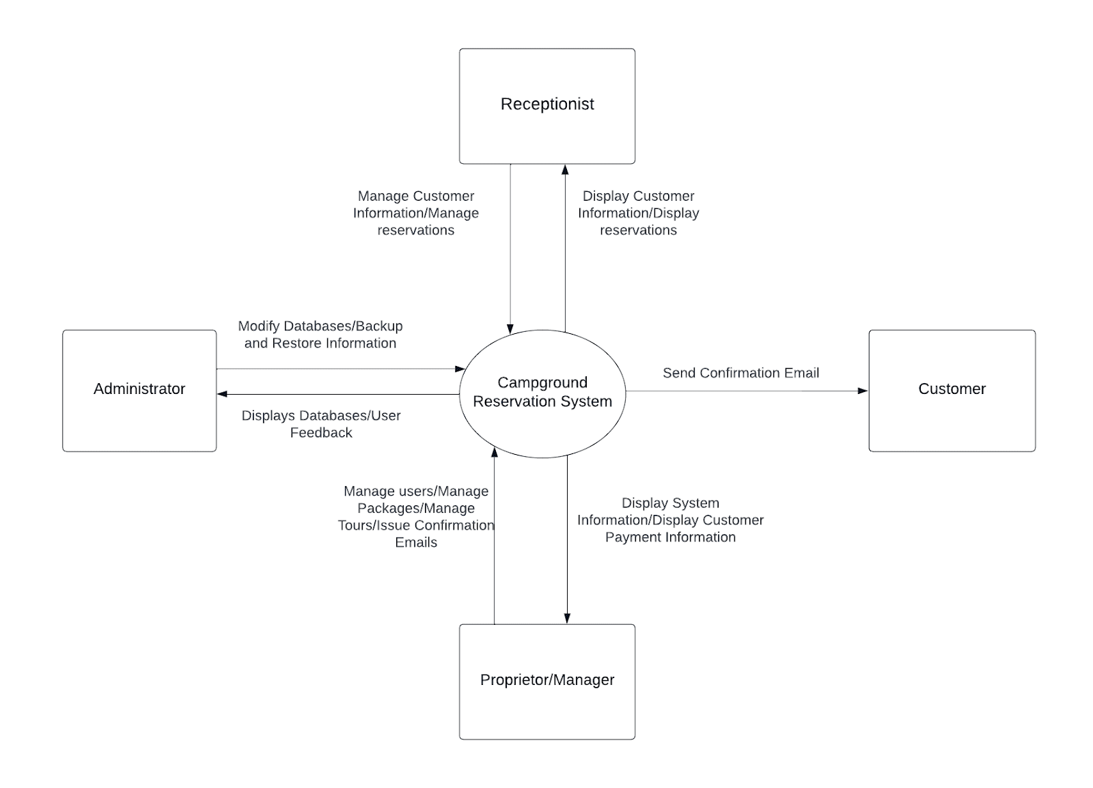
Context Diagram

Slide 14
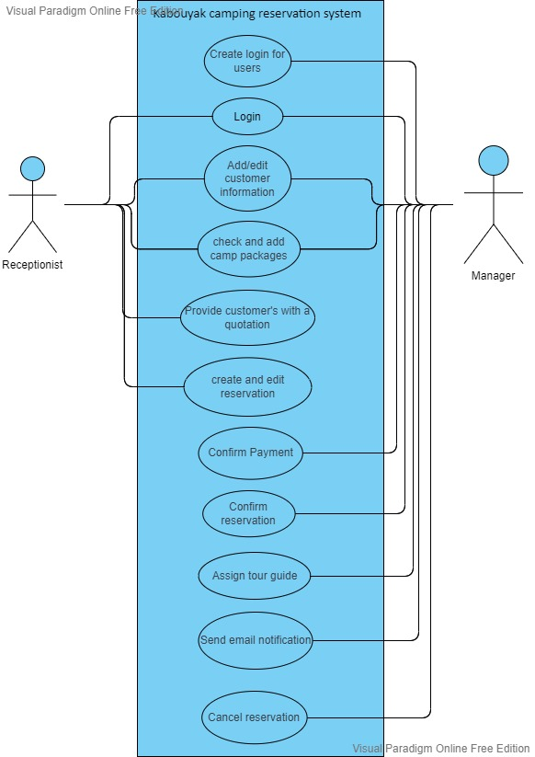
Use Case Model

Slide 15
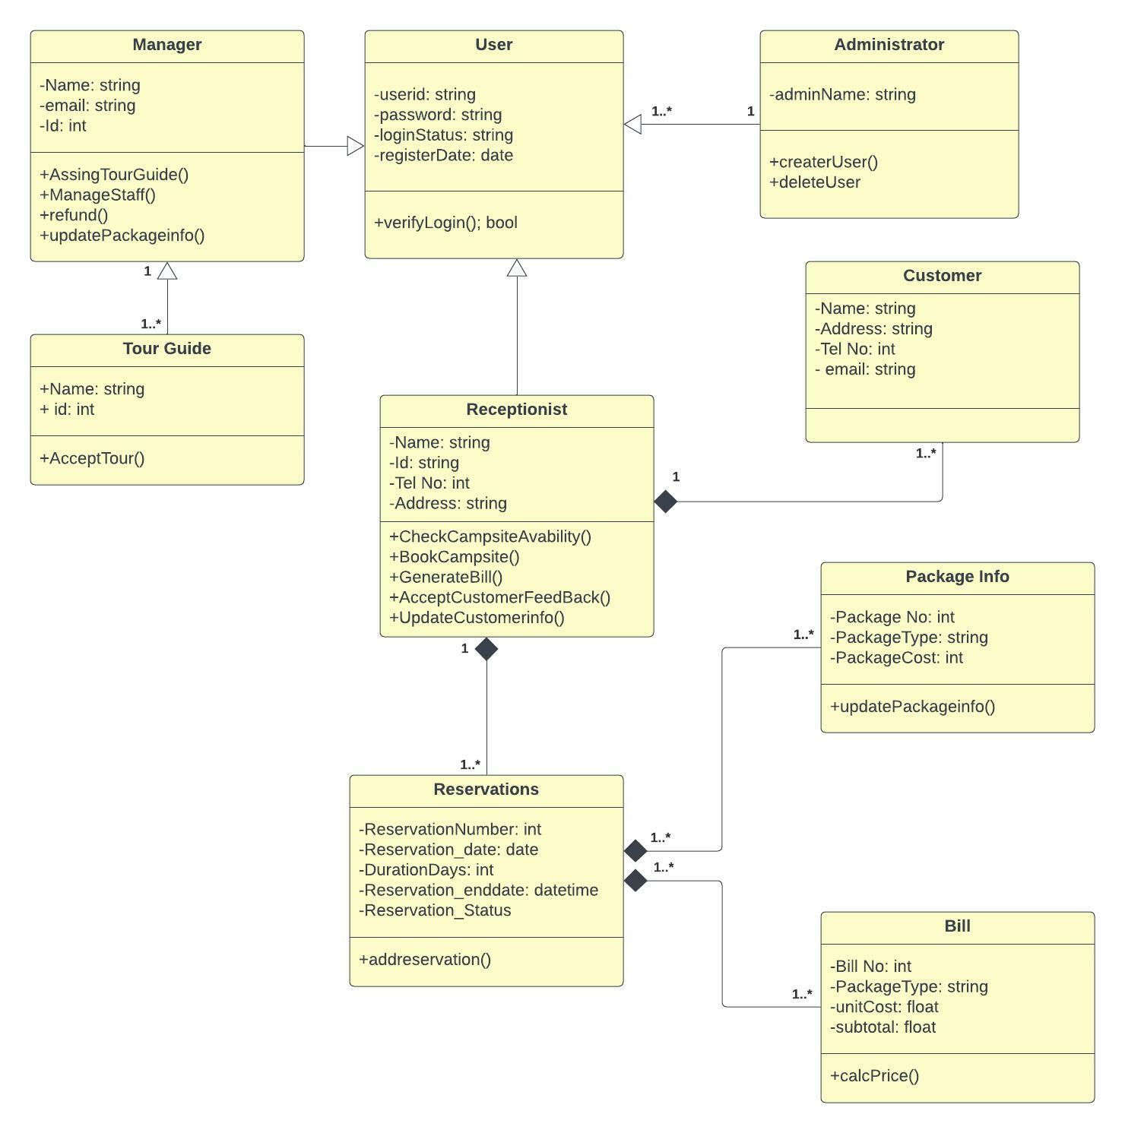
Class Diagram

Slide 16
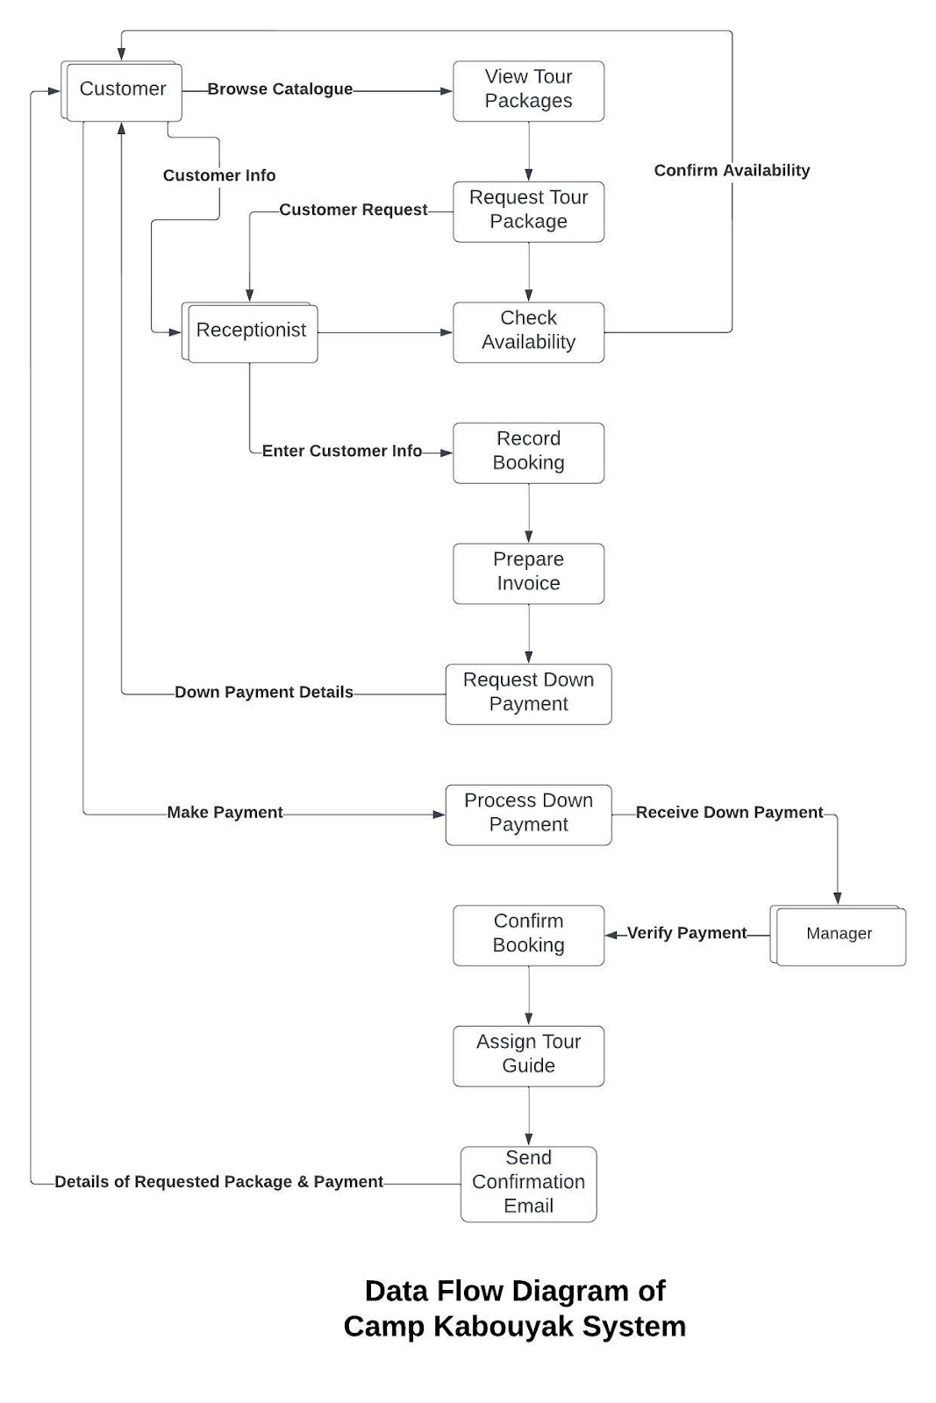
System Architecture

Slide 17
System Testing

Slide 18
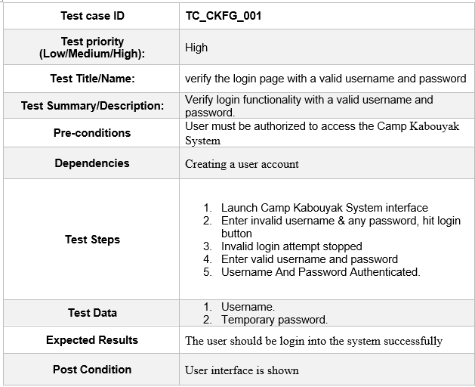
Test Case TC_CKFG_001

Slide 19

Questions and Comments

